Slide 1
试题结构
3
部分 | 节次 | 题型 | 题数 | 分值
听说 | 第一节 | 听选信息 | 4+10 | 21
 | 第二节 | 听后转述 | 4+1 | 15
 | 第三节 | 朗读+回答 | 1+3 | 14
知识运用 | 第一节 | 完形填空 | 10 | 15
 | 第二节 | 语法填空 | 10 | 15
阅读理解 | 第一节 | 阅读选择 | 14 | 28
 | 第二节 | 信息还原 | 5 | 10
书面表达 | 第一节 | 阅读表达 | 4 | 12
 | 第二节 | 情景作文 | 1 | 20

Slide 2
文本选择
篇目 | 文体 | 话题 | 主题内容
完形填空 | 记叙 | 家族传统的价值 | 专题2：人际关系的处理-人与世界
语填A | 记叙 | 常德丝弦的传承 | 专题6：中华文明的贡献
语填B | 说明 | 人工智能的应用 | 专题3：人类社会的发展-技术
语填C | 议论 | 信任机制的产生 | 专题3：人类社会的发展-伦理
阅读A | 应用 | 公益机构的运行 | 专题3：人类社会的发展
阅读B | 记叙 | 自我审视的历程 | 专题1：个人发展的轨迹-身心
阅读C | 说明 | 情感因素的作用 | 专题1：个人发展的轨迹
阅读D | 议论 | 沉浸体验的探讨 | 专题3：人类社会的发展-技术
信息还原 | 说明/ | 内心力量的获取 | 专题1：个人发展的轨迹
阅读表达 | 记叙 | 弱势群体的声音 | 专题1：个人发展的轨迹

Slide 3
4
难题解析
复习建议
5

Slide 4
◆难题解析—听力
10. What’s the man doing?
A. Assigning the woman a task.
B. Reviewing the woman’s work.
C. Checking the woman’s qualification.
语言表达的丰富性
思维的深刻性
Interview—从本质上来讲是考查一个人的资质

Slide 5
转述阅卷发现问题：
1. 为了信息全面，牺牲转述质量
2. 通篇用 I 或Sam来转述
3. 花时间去记忆并转述Hope these suggestions will help you…
提取关键信息、整合信息、排除无关信息

Slide 6
朗读阅卷发现问题
1. 朗读不流畅、卡顿、语言错误较多
（不要单个单个去记忆单词，要有语块、有语境）
2. 回答问题冗余信息多
信息的定位—跟阅读相结合

Slide 7
It grounds me.
Grow up. It’s ingrained in me.
Grandpa passed away. I chose what he would’ve chosen.
It’s a tradition. But why?
体悟传统
省视价值
践行传统
感受宁静
借助传统
走出泥泞
初识传统
诸多迷惑
Tradition carries us when we cannot carry ourselves. Tradition shapes who we are.

Slide 8
No one had the energy for the usual noise and celebration. 6 , my grandmother insisted we should keep the tradition going.
A. Still B. Instead C. Meanwhile D. Therefore
0.40
0.25
0.18
0.17
Still（仍然，尽管如此）：表转折让步，符合 “虽无精力，但仍坚持传统” 的逻辑，衔接自然。
Instead（相反）: “in the place of sb/sth”, 表示替代方案，但这里没有提出替代行为，没说 “放弃传统换其他事”，而是直接转折，因此不合适。
Meanwhile（与此同时）：表并列同步，强调两个动作同时发生，无法体现前后句的转折关系。
Therefore（因此）：表因果关系，前一句是 “无精力” 的否定情境，不能作为 “坚持传统” 的原因，逻辑不通。

Slide 9
That year, I chose a pear — my grandfather’s favorite. As I bit into it, I felt closer to him. In that moment, I realized this tradition wasn’t just
8 our holiday, but also me.
A. changing B. shaping C. involving D. honouring
0.22
0.50
0.20
change: Tradition 为什么要改变 holiday？
shape: “to have an important influence on the way that sb/sth develops” 塑造；影响…的发展。完美地描述了传统如何潜移默化地定义节日的内涵，并塑造着“我”的情感、记忆和身份认同。
involve: 包含, 涉及。这个词语气太弱。Involving me 仅仅表示“有我参与”，完全没有表达出这种传统对“我”产生的深刻情感冲击和内在影响。

Slide 10
Other times, I sit with a bowl of fruit and reflect quietly. It 10 me. It reminds me where I come from and what matters most to me.
10. A. frees B. judges C. grounds D. consumes
①语境 It reminds me where I come from and what matters most to me.
②排除B D 负向
③ ground—地面—>以地面为依靠—>提供稳定感和安全感—>归属感和身份认同
frees: 解放, 释放。侧重 “摆脱束缚”，但句子核心是 “明确归属与重点”, 语义不匹配。
judges: 表 “对人 / 事下判断”, 与 “反思、提醒根源” 的语境无关，不符合逻辑。
grounds: 使立足，使踏实。此处为动词用法，完美契合 “通过反思明确根源与重点” 的语境，与后句 “reminds me where I come from...” 形成语义呼应。
consumes: 消耗，占据。多表示 “消耗时间 / 精力” 或 “被某种情绪占据”，此处无 “消耗” 含义，且感情色彩不符。

Slide 11
◆难题解析—语法填空
理解长难句，提取句子主干
T 14.
A new movie empowered by AI centres on Su Shi __14__ (witness) how Hainan has evolved into a bustling trade port.
提取主干：A new movie centres on sth
句子结构梳理：
主语：A new movie
定语：empowered by AI
谓语：centres on
宾语：Su Shi witnessing how...（动名词复合结构作宾语，witnessing后为
how引导的宾语从句）

Slide 12
◆难题解析—语法填空
深度理解语篇，关联语境
T 19. 19 cities and governments, early humans had to depend on each other.
Trust is part of our nature. It 18 (build) into us through thousands of years of evolution. 19 cities and governments, early humans had to depend on each other. They lived in small groups where working together wasn’t optional. It was a matter of survival. Trust came out of 20 (necessary), not choice.
Evolution：a long process
Necessity: a result of evolution
Choice: with/without

Slide 13
学生了解词性的用处吗？
学生能在词性和句子成分间建立关联吗？
如何用学生理解的语言明晰这些概念？
survive—survival
arrive—arrival
approve-approval
remove—removal
revive—revival
……

Slide 14
语法的核心
所 谓 语 法
句 子 结 构
动 词
A new movie empowered by AI centres on Su Shi 14 (witness) how Hainan has evolved into a bustling trade port.
形
式
主 动
与
被 动
意
义
不
及
物
及
物
词 性
应 用

Slide 15
◇语法填空复习建议
思维导图→主题词汇 （词汇群）
利用规律→词性变化 （构词法）
探究规律 → 语法规则 （表意）
启发
探究
语境
使用
关注
基础知识、核心知识，语篇理解；不抠边角；
思维导图→主题词汇 （词汇群）

Slide 16
阅读理解
年份 | A | B | C | D | 信息还原 | 总计
2023 | 235 124 | 383 135 | 367 117 | 426 149 | 255 83 | 1666 608
2024 | 240 97 | 354 119 | 406 135 | 384 120 | 281 89 | 1665 560
2025 | 238 94 | 363 126 | 402 89 | 401 123 | 269 86 | 1673 518
海淀 期中 | 299 105 | 402 124 | 433 82 | 454 123 | 257 105 | 1845 539

Slide 17
Beginning
A PI came and examined what was inside the house
Developing
I got to know more about myself through reading the analysis
Climax
I was the PI.
How the game works
Ending
The benefits of uncovering things about yourself
B
Inspiration
for us?
It might take something to know ourselves better.
A new world opens up once we do that.

Slide 18
经典试题—阅读理解
B
26. What can we know about the writer?
A. She likes red stuff.
B. She ignores her strengths.
C. She is good at story writing.
D. She dislikes tidying up rooms.
P4: “I made it myself,” I said. “I love the cherry-red fabric.”
P8: When I did this, I realized my wardrobe choices didn’t reflect my true style. I preferred comfort and light colors over high heels and reds.
P9: Your personal space holds clues about your talents, interests, and desires — things you may have overlooked.
P3: His daughter had asked for my help turning his stories into a literary family legacy.
P4: She ran her finger along the spines, mouthing titles of autographies
All about the room (scene) but nothing actually about the room.
细节获取—细节理解—信息转换—分析判断

Slide 19
27. What can we learn from the story?
A. People with a detailed profile enjoy a fulfilling life.
B. A shift in perspective reveals one’s hidden aspects.
C. Self-discovery requires reevaluating possessions.
D. An original portrait displays one’s inner world.
B
14.1%
38.8%
28.7%
18.2%
A shift in perspective = examine yourself through the lens of the Private Investigator
one’s hidden aspects = things you might otherwise not know about yourself 信息转换→语言表达的丰富度
Self-discovery requires reevaluating possessions.
概念?
选大词策略？

Slide 20
C
somatic marker hypothesis
What: emotions are key to decision making; they are bodily processes that signal value, influence risk assessment, and speed up judgements
Back-up research:
neurological patients with damage to the brain’s frontal lobe reveal impaired decision making and a compromised ability to express emotion and to experience feelings
Conclusion: somatic response is what drives decision making.
popular belief/desire:
do away with emotions altogether; remain calm and peaceful

Slide 21
C
28. What did Damasio find about patients with frontal lobe damage?
A. Failure to learn some social skills.
B. Decline in their working memory.
C. Inability to express their emotions.
D. Difficulty in making wise decisions.
But in all other aspects of intellect — basic attention and working memory, …even their knowledge of social issues — the patients were otherwise perfectly fine.
…a compromised ability to express emotion
compromised ability ≠ inability 高混项
…语篇核心
Notes:
But in all other aspects of intellect — basic attention and working memory, the ability to use logic in the solution of problems, the learning of factual knowledge and skills, even their knowledge of social issues — the patients were otherwise perfectly fine.

Slide 22
C
29. What does the word “somatic” underlined in Para.3 most possibly mean?
A. Bodily. B. Emotional. C. Intellectual. D. Logical.
37.2
Without emotion and the accompanying somatic markers — a pounding heart rate, tight face, lump in the throat, dry mouth, butterflies in the stomach, sweaty hands, and so forth
概念出现在Para 3，直接解题依据出现在Para 5.
不套路，唯能力

Slide 23
C
A. Feeling Our way
跟着感觉走(双关）
B. Head Ruling Heart
理性压倒感性
D. Trusting Our Senses
相信我们的感官
C. Calm Before Storm
山雨欲来风满楼
Emotions play a vital role in decision making
与语篇
主旨相反
Title
senses 包含范围更广
跟语篇关系不紧密

Slide 24
D
行文逻辑
Lead in
Introduce the topic of immersive entertainment
Personal exposure
Powerfully emotive, exhilarated…
Insularity worries me
Different opinions
Keren Zaiontz
Luke Kemp, Robyn Landau, Sophie Janicke-Bowles
Author’s opinion
It does … but …

Slide 25
D
Immersive entertainment
Keren Zaiontz
narcissistic spectatorship
(research) addiction to the experience and isolation
respond to our need for “playful” cultural spaces;
allows the audience to feel part of something
Author (I)
I am torn about where the rapidly developing scene is taking us. It does give us an opportunity to tune into ourselves, but I am less convinced it amplifies our bond with those around us…
Luke Kemp
the link to interoception —our awareness of our body’s inner senses. “…connect us to ourselves, …transform how we show up in the world and the way we connect to others
Robyn Landau
Sophie
Janicke-Bowles
can have an incredible recovery effect on our mind, … detach from our everyday concerns and cognitively, emotionally and even physiologically get absorbed into something different

Slide 26
D
Luke Kemp
Keren Zaiontz
Author (I)
Robyn Landau
Sophie
Janicke-Bowles

Slide 27
D
31. What can we learn about the author’s immersive experiences?
A. They free the author from restrictions.
B. They lift the author out of an awful mood.
C. They leave the author feeling alone in the crowd.
D. They cause the author to be emotionally unstable.
以偏概全；not the author’s major concern
无中生有
对insularity
的解释
0.35
0.36
having difficulty regulating one’s emotions, leading to intense, unpredictable, and rapidly shifting emotional states

Slide 28
D
32. What can be inferred about Luke Kemp’s view on immersive experiences?
A. They make people feel included. B. They lead to self-focused perspectives.
C. They help with mental wellness. D. They transform our social interactions.
Luke Kemp, who heads up the Barbican’s immersive programming, says these experiences respond to our need for “playful” cultural spaces, accessible regardless of prior knowledge: “It allows the audience to feel part of something”.
To feel part of something = to feel included 信息转换

Slide 29
D
33. The author mentions Your Inner Symphony mainly to ______.
A. restate an argument B. propose a concept
C. provide an example D. present an opinion
0.33
Luke Kemp, who heads up the Barbican’s immersive programming, says these experiences respond to our need for “playful” cultural spaces, accessible regardless of prior knowledge: “It allows the audience to feel part of something”.

Slide 30
D
34. The author considers Sophie Janicke-Bowles’s view ______.
A. partial B. insightful
C. confusing D. practical

Slide 31
Sophie Janicke-Bowles, immersive experiences “can have an incredible recovery effect on our mind, where we can detach from our everyday concerns and cognitively, emotionally and even physiologically get absorbed into something different”.
I am torn about where the rapidly developing scene is taking us. It does give us an opportunity to tune into ourselves, but I am less convinced it amplifies our bond with those around us. If we remain fixated by our own reflections, then we are missing the bigger picture. Immersive entertainment might make VIPs of us all, but culture should also bring us together.
Yes, you are right.
Yes, you are
missing the bigger
picture.
=You are partial.
Not only you, but
most of you, fail to see
this point.

Slide 32
一道题的前世今生
D
初代
What is the author’s attitude towards immersive entertainment?
A. Concerned. B. Positive. C. Neutral. D. Disapproving.
二代
As for Sophie Janicke-Bowles’s argument, the author is______.
A. disapproving B. sympathetic C. unconcerned D. objective
三代
As for Sophie Janicke-Bowles’s view, the author is ______.
A. skeptical B. sympathetic C. unconcerned D. puzzled

Slide 33
D
四代
As for Sophie Janicke-Bowles’s view, the author is ______.
A. skeptical B. sympathetic C. confused D. curious
最终代
The author considers Sophie Janicke-Bowles’s view ______.
A. partial B. insightful C. confusing D. practical

Slide 34
对作者态度的再度思考
对skeptical的界定
对argument概念的界定；
对态度的考量
作者对该行业的态度→作者与语篇中某位人士的观点比对
argument
→ View
Disapproving
→ skeptical
作者的态度
→作者的评价
贴近近年高考
对高考命题的研究
对语篇的深入研读
对概念的清晰界定

Slide 35
◆ 信息还原
Gratitude
Traits linked to self-trust during uncertainty
Uncertainty
Para. 4 & 5
What is gratitude, the power of gratitude； the way to practice gratitude
Para. 3
gratitude, love and hope
Para. 1+2
Darkness/fear → inner strength

Slide 36
微技能
句间逻辑
过渡句
指代对象
段落间逻辑
段首句功能
段尾句功能

Slide 37
This group excelled in three emotional character strengths—gratitude, love, and hope — known as the “Harmony Triad.” 37
E. They promote harmony and resilience, and importantly, they can be taught and developed.
F. These strengths are valuable as they arise naturally in times of crisis and play a vital role in hardship.
value
way to practice
只匹配，不分析
跟后文的ways to practice gratitude有根本性矛盾
启示：整体把握语篇意义；
勿囿于微/伪技巧

Slide 38
启示：长句分析；行文逻辑
Gratitude, the most studied of the three, is particularly powerful. It focuses on what has already happened, requiring no invention or manipulation. 38 Instead of recalling only average events, asking for “three things you were grateful for yesterday” directs the brain to retrieve positive experiences. Over time, this reshapes our perspective, helping us savor moments and feel better. Daily challenges—political, financial, or personal—are unavoidable, but they need not consume us. By practicing gratitude, we train our minds to notice what uplifts us. This shift in perception fosters self-trust, reminding us that peace and strength lie within.
A. Practicing gratitude changes how our brain searches memories.
D. Try it now: recall three experiences from the last 24 hours that made you grateful.
主语
value
way to practice → next para.

Slide 39
行文逻辑
way to practice
39 Savor them. This simple practice opens the door to inner peace, proving that storms may rage, but stars still shine.
D. Try it now: recall three experiences from the last 24 hours that made you grateful.
A. Practicing gratitude changes how our brain searches memories.
出现在此处是个新概念
Para. 4 讲power；Para. 5 先讲way to practice，再说这样做的意义

Slide 40
阅读教学建议
1. 依托主题，建构意义
2. 基于主题，发展思维
3. 深研语篇，意义为先
4. 全篇视角，理解概念

Slide 41
◆书面表达
关注核心素养
考查思维品质
用语言做事情
体现
社会主义
核心价值观
关注现实生活

Slide 42
阅读表达
Life with autism
Joined media club
Discovered the world of podcasting
Started my own podcast
Had listeners telling me …
The podcast has reached places I never expected. Looking back…
At the very
beginning
Toward the end
of freshman year
Later…
now…
Transformation → Growth

Slide 43
What led to the Growth?
Growth
Self-acceptance
Bravery to try
The thirst to be heard
persistence
Connection with others
From this story,
what can you learn about growth?
启示：深研语篇，建构意义！

Slide 44
应用文写作
假设你是红星中学高三学生李华。你的英国好友Jim对你校即将开展的“青春创意，温暖邻里”的社区公益活动很感兴趣，发来邮件向你询问。请你用英文给他回复邮件，内容包括：
1. 活动内容；
2. 活动意义。

Slide 45
青
春
创
意
社区公益活动
温
暖
邻里
活动组织：学校
行动主体：“青春”—青少年学生
活动特点：创意+温暖
行为对象：邻里

Slide 46
活动特质
基于邻里
青少年视角
互动与链接
可操作性强
效果可预见

Slide 47
青少年视角
主动
参与
情感
联结
理想
主义
促进
成长

Slide 48
可操作性
是否符合社区实际
是否适合青少年执行
是否符合学校设定

Slide 49
效果可预见
Do a survey about what the community needs
Have a discussion about what to do
Note： 计划、讨论在行动之前，
计划千遍不如一干
只有行动才有效果

Slide 50
创意+温暖
艺术
美化类
“我们的社区故事”主题墙绘
代际
融合类
“数字时代”青少年讲师团
环境
保护类
邻里共建花园
知识
共享类
“放学后”趣味学习角
“旧物新生”公共艺术展
“时光记忆”口述史采集
“以物易物”儿童公益市集
“生活黑客”青少年工作坊

Slide 51
这些活动体现题目要求吗？
单纯的社区卫生清扫
传统的募捐或发传单
在社区进行才艺表演
社区商品义卖活动
上门维修电器、水管
为社区投放冰箱
缺乏创意，过于传统
被动执行任务
单向输出
非公益活动
有安全隐患
超出青少年承受能力

Slide 52
审题三问
这个活动，如果没有我们青少年的‘创意’和‘热情’，还能由其他群体完成吗？
这个活动的核心是‘双向的互动与连接’，还是‘单向的给予或说教’？
这个活动超越了传统形式的‘创新点’在哪里？

Slide 53
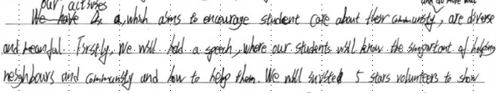
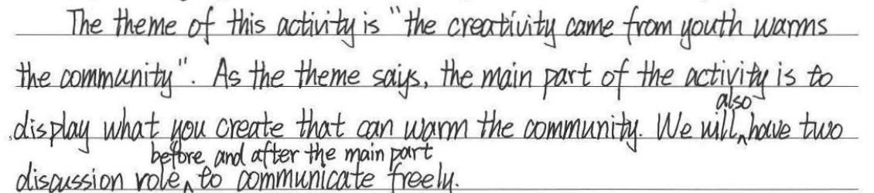
阅卷所见major problem
1. 概念混淆 用活动安排/解释代替活动内容

Slide 54
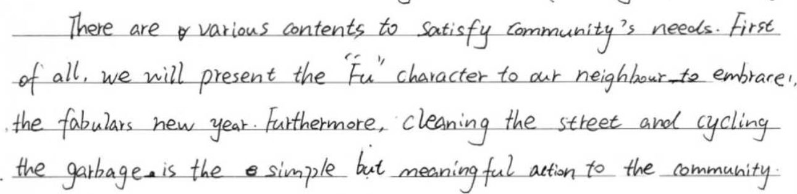
2. 概念缺失 创意 温暖 邻里 不能得兼
给社区赠送节水装置
救助流浪猫
在社区捡垃圾
…….

Slide 55
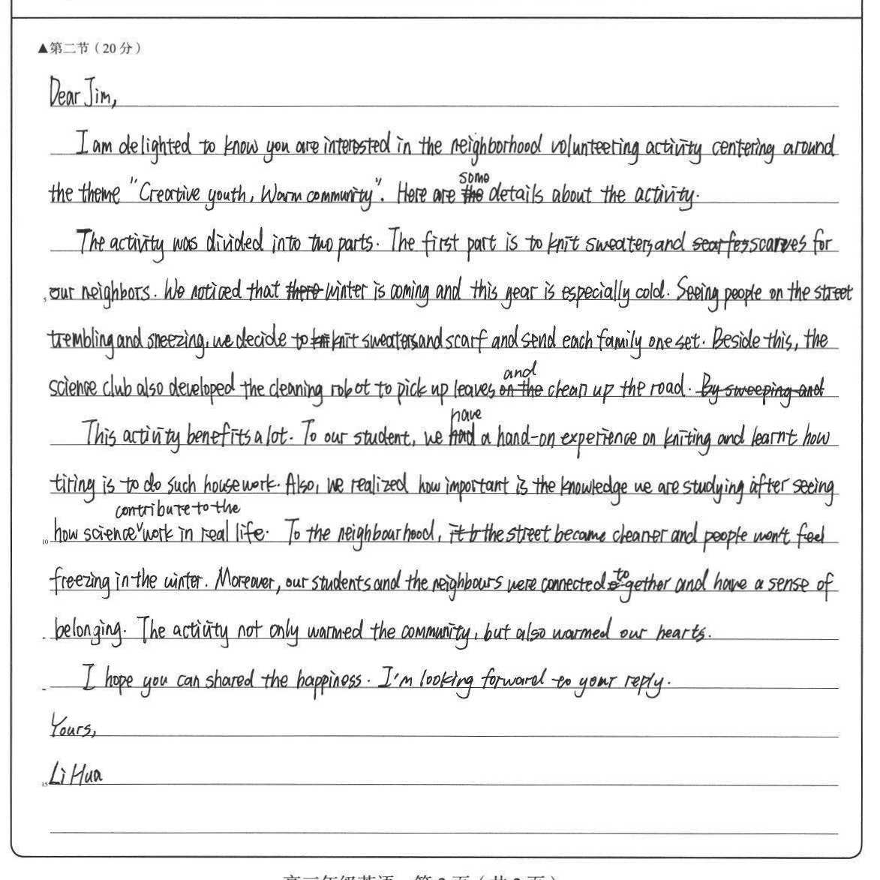
3. 思维低幼化
把温暖理解为肢体感受

Slide 56
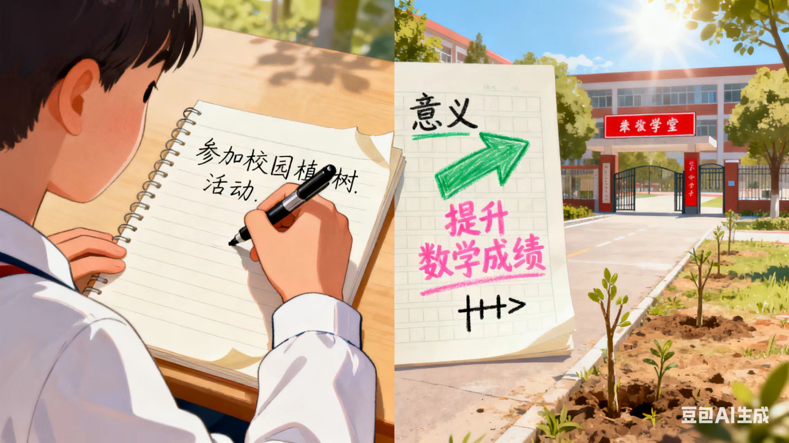
4. 意义和活动之间匹配度低

Slide 57
5. 比例不当
活动描述宽泛且简短
意义描述极为冗长

Slide 58
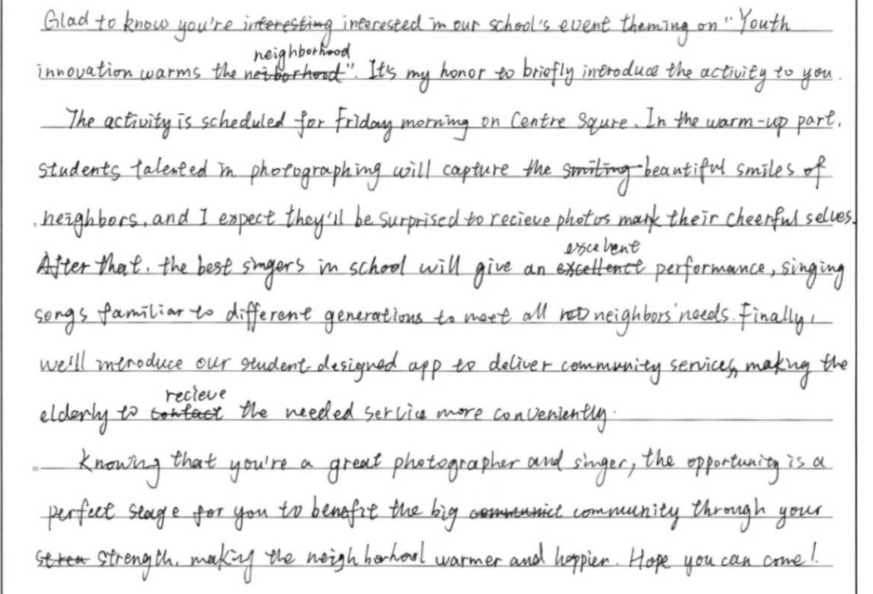
6. 生搬硬套的痕迹太重

Slide 59

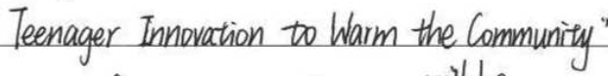
1. 不建议翻译题目 2. 现阶段不建议背诵太多模板 要真实表达 3. 建议把控字数
几点小建议

Slide 60
写作复习建议
通过主题复习，建构知识体系，发展思维品质
引导学生进行概念界定
提升解题的精准度
培养学生良好习惯
避免书写、超行扣分
及时提炼学生的问题
追根溯源
找准方向
The most certain way to succeed is always to try just one more time.

Slide 61
总体讲评建议
由知识到能力
1
切忌就题论题
细雨湿衣看不见
闲花落地听无声
以讲评 带旧知,引新知，形成知识滚动
2
切忌一言堂
掰开揉碎融入专题细讲
静
3
切忌囫囵吞枣

Slide 62
当前至期末的关键问题
1. 如何利用主题复习内容科学备考，促成学生知识体系的初步建立？
2. 如何平衡主题复习与听口备考、专题复习的关系？
3. 如何维持科学备考与保持学生学习兴趣的平衡？（您认为的科学备考应该是什么样的？学生不感兴趣=无效备考吗？）

Slide 63



同舟共济
相互成全
我们成全学生的梦想，
他们成全我们的幸福。
Thank you for
never even wanting to give up.

Slide 64
谢 谢！
本视频课程中的部分图片、视频引自有关图书、网络，特向这些图片、视频的制作者和有关图书的出版者和相关网络表示感谢；因多种原因，事先未与作者和出版社取得联系，特向他们表示歉意。

